Slide 1
Van Musschenbroek on Newton’s regulae philosophandi, Aquatic Polyps, and the Dangers of Analogy
Steffen Ducheyne

Slide 2
Outline
1. Newton’s regulae philosophandi III and IV
2. Pieter van Musschenbroek (1692–1761): An astute commentator on Newton’s regulae philosophandi
3. Rule IV, aquatic polyps, and the dangers of analogy
4. Conclusion

Slide 3
* Constraining mathematical imagination by experience: Nieuwentijt and van Musschenbroek on the abuses of mathematics, Synthese (in print).
* (with Pieter Present) Pieter van Musschenbroek on laws of nature, The British Journal for the History of Science, vol. 50(4), 2017, pp. 637-656.
* Curing pansophia through eruditum nescire: Bernard Nieuwentijt’s (1654–1718) epistemology of modesty, HOPOS, vol. 7(2), 2017), pp. 272-301.
* Different shades of Newton: Herman Boerhaave on Newton mathematicus, philosophus, and optico-chemicus. Annals of Science, vol. 74(2), 2017, pp. 108-125.
* Petrus van Musschenbroek on the scope of physica and its place in philosophy, Asclepio, Revista de historia de la medicina y de la ciencia, vol. 68(1), 2016, Article number: 123.
* Petrus van Musschenbroek and Newton’s “vera stabilisque Philosophandi methodus”, Berichte zur Wissenschaftsgeschichte, vol. 38(4), 2015, pp. 279-304.
* “Celeberrimus Atheismi patronus præcedentis sæculi”: Petrus van Musschenbroek’s Anti-Spinozism unveiled, Lias, Journal of Early Modern Intellectual Culture and its Sources, vol. 41(2), 2014, pp. 173-197.
* W. J. ’s Gravesande’s Appropriation of Newton’s Natural Philosophy, Part I and II, Centaurus, vol. 56(1-2), 2014, pp. 31-55, pp. 97-120.

Slide 4
1. Newton’s regulae philosophandi III and IV

Slide 5
Newton distinguished between:
Universal qualities: qualities that cannot be acquired and lost
Non-universal qualities: qualities that can be acquired and lost
Universal-relational qualities: universal qualities that can be increased and diminished
Universal-immutable qualities: universal qualities that cannot be increased and diminished

Slide 6
In experimental philosophy propositions collected from phenomena by induction should be held either accurately or as most closely as possibly true, notwithstanding any contrary hypotheses, until other phenomena make these propositions more accurate or liable to exceptions.

Slide 7
2. Pieter van Musschenbroek (1692–1761): An astute commentator on Newton’s regulae philosophandi

Slide 8
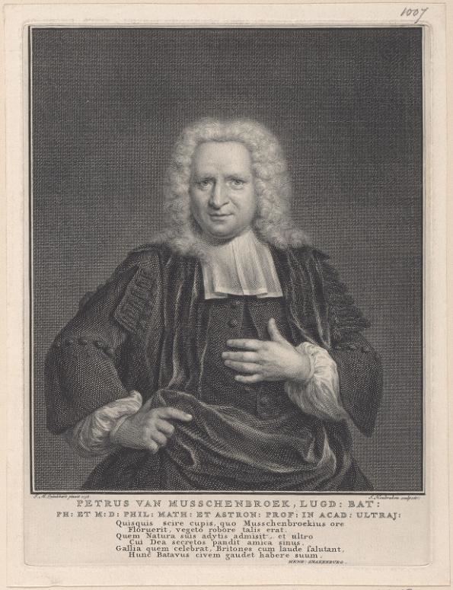

Slide 9
Such qualities of bodies as can neither be intended and remitted, and which belong to all bodies as far as our experiments will reach, ought to be esteemed the qualities of all bodies whatever.

Slide 10
3. Rule IV, aquatic polyps, and the dangers of analogy

Slide 11
And although the arguing from Experiments and Observations by Induction be no Demonstration of general Conclusions; yet it is the best way of arguing which the Nature of Things admits of, and may be looked upon as so much stronger, by how much the Induction is more general. And if no Exception occur from Phænomena, the conclusion may be pronounced generally. But if at any time afterwards any Exception shall occur from Experiments, it may then begin to be pronounced with such Exceptions as occur.

Slide 12
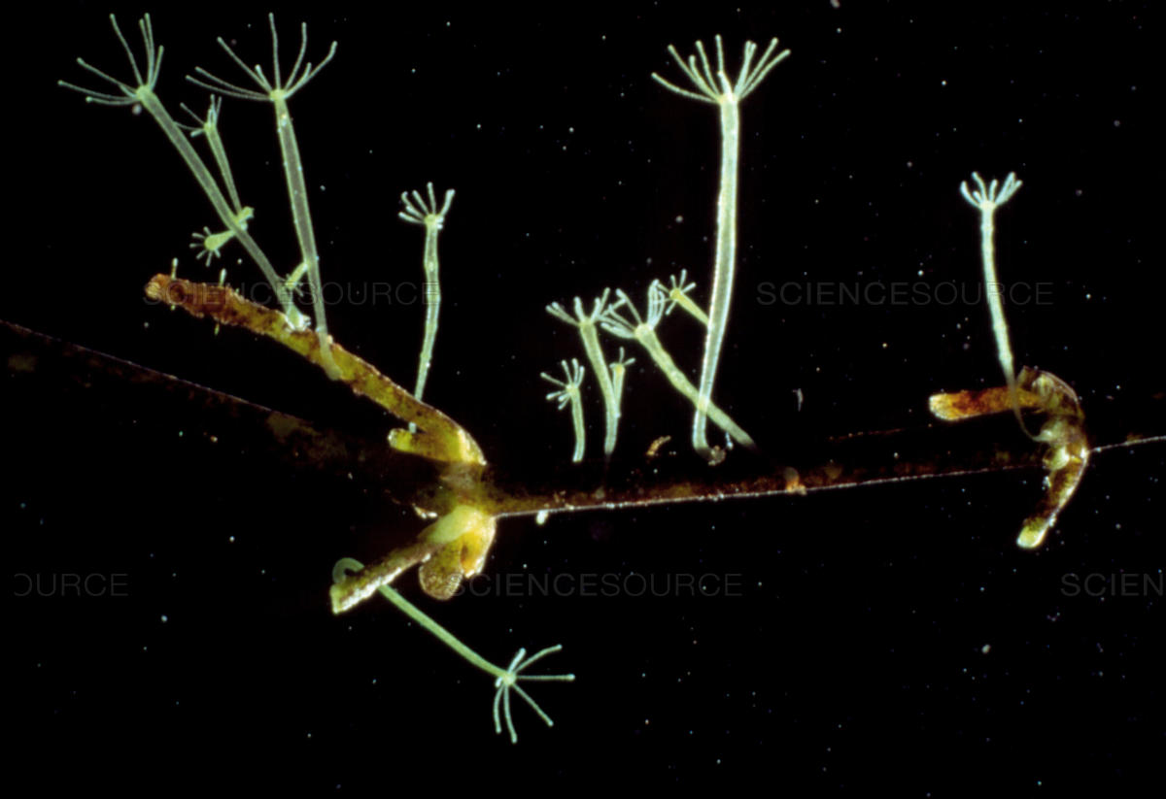
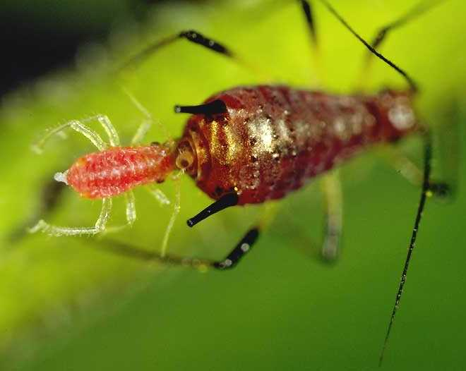

Slide 13
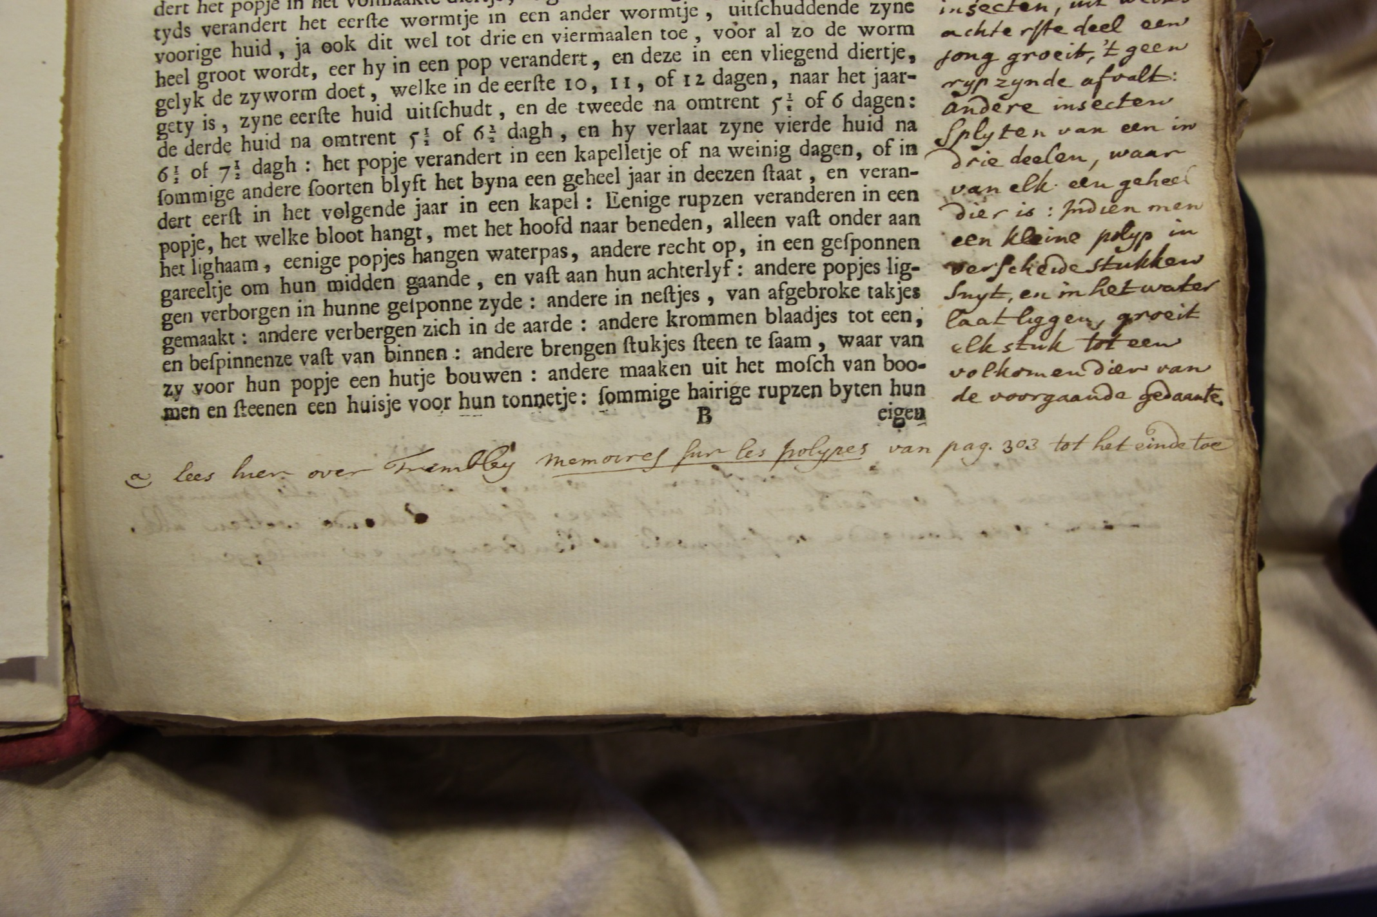

Slide 14
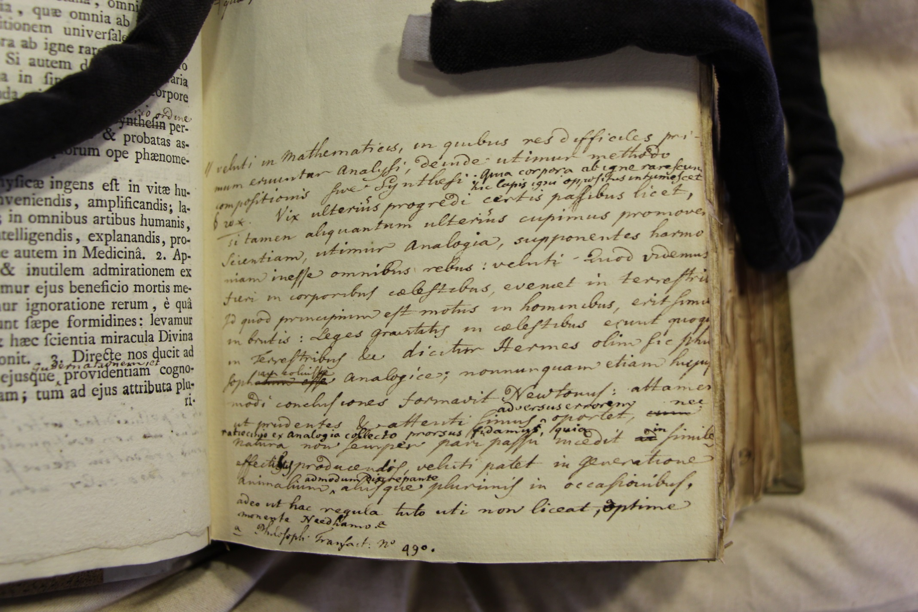

Slide 15
The Method of Reasoning by Analogy is but too apt to lead us into Mistakes, and therefore we ought to be very diffident of Consequences deduced this Way. Every new Appearance that has no known Cause, immediately fixes, and but toooften at last puts the Thoughts of the Observer upon the Rack. When the Mind arrives at this Intensity of Action, how natural is it to free ourselves from a painful Uncertainty at any rate, and that with as little Expence of Reflection as may be? The most obvious and easy Method is to class, if it admits it, and to reduce it so some other known Phænomena; possibly we are yet no nearer the physical Cause, because that of both is unknown. We have still, however, the Satisfaction to have diminished the Surprize it gives, by taking from its Singularity, rest in some measure contented with this little Deceit. I call it a Deceit, if we acquiesce in it, tillsuch time as a Number of Circumstances shall concur to place it above the State of an Hypothesis, and shew us we have been right in our Inferences. Mere Analogy, founded only upon one or two Facts, and extended by Conjecture, however plausible, can but at most furnish Motives for a reasonable Doubt, and a more mature Enquiry.

Slide 16
4. Conclusion

