Slide 1
Philosophy of biology before biology?
A methodological provocation
Charles Wolfe (UGent) (*)
Scientific Reasoning in Action –
From the Early Modern Period to 1900
Ghent, October 12, 2018
(*) based on work done with Cécilia Bognon-Küss (IHPST Paris)

Slide 2
‘Biology’ as a discipline
Official date of birth 1802 (Lamarck, Treviranus)
But used in earlier decades
And there are competitor terms for a science of life (including ‘natural history’ used in a broad sense) – they reflect a ‘practice’ and the need for a ‘theory’ (unification)
And such terms persist will after 1802 (zoonomy, as in Erasmus Darwin; biogeography, etc.)

Slide 3
Philosophy of biology vs
Biological philosophy
Auguste Comte: “biological philosophy” (1830s); William Whewell: “philosophy of biology” (1840s)
20th century biological philosophy:
  Kurt Goldstein, Der Aufbau des Organismus (1934), Georges Canguilhem, La connaissance de la vie (1952, 1965), Hans Jonas, The Phenomenon of life (1966); differently, J.S. Woodger, Biological Principles (Woodger 1929)

Slide 4
Philosophy of biology as a field
Gayon 2009, Pradeu 2017: predominance of evolutionary biology (and molecular biology) in 30 years of articles in Biology and Philosophy (1986-2003, 2003-2015)
“Traditionally, evolution has been the focus of most philosophical attention. While it surely remains true that ‘nothing in biology makes sense except in light of evolution’ (Dobzhansky, 1973), this tradition within the philosophy of biology is myopic insofar as it ignores much - if not most - of the work in contemporary biology” (Sarkar and Plutynski 2008, xviii).

Slide 5
&HPS and historical epistemology
“a theory of knowledge without reference to epistemology would be a meditation on the void ... an epistemology without any relation to the history of science would be a wholly superfluous clone of the science which it claims to discuss.” (Canguilhem 1968, 11-12)
“Good HPS is not just history of science into which some philosophy of science may enter, or philosophy of science into which some history of science may enter. It is work that is both historical and philosophical at the same time. The founding insight of the modern discipline of HPS is that history and philosophy have a special affinity and one can effectively advance both simultaneously” (my emphasis) (&HPS2, U. of Notre Dame, 2009).
“forcing the concept to show itself, in the history of science” (Gayon 1995, 464-465)

Slide 6
Three conditions for the emergence of biology:
‘phenomena’ (embryogenesis, monsters etc)
‘taxonomy’ (natural history, classification)
‘definition’ / criteria (what is life?)

Slide 7
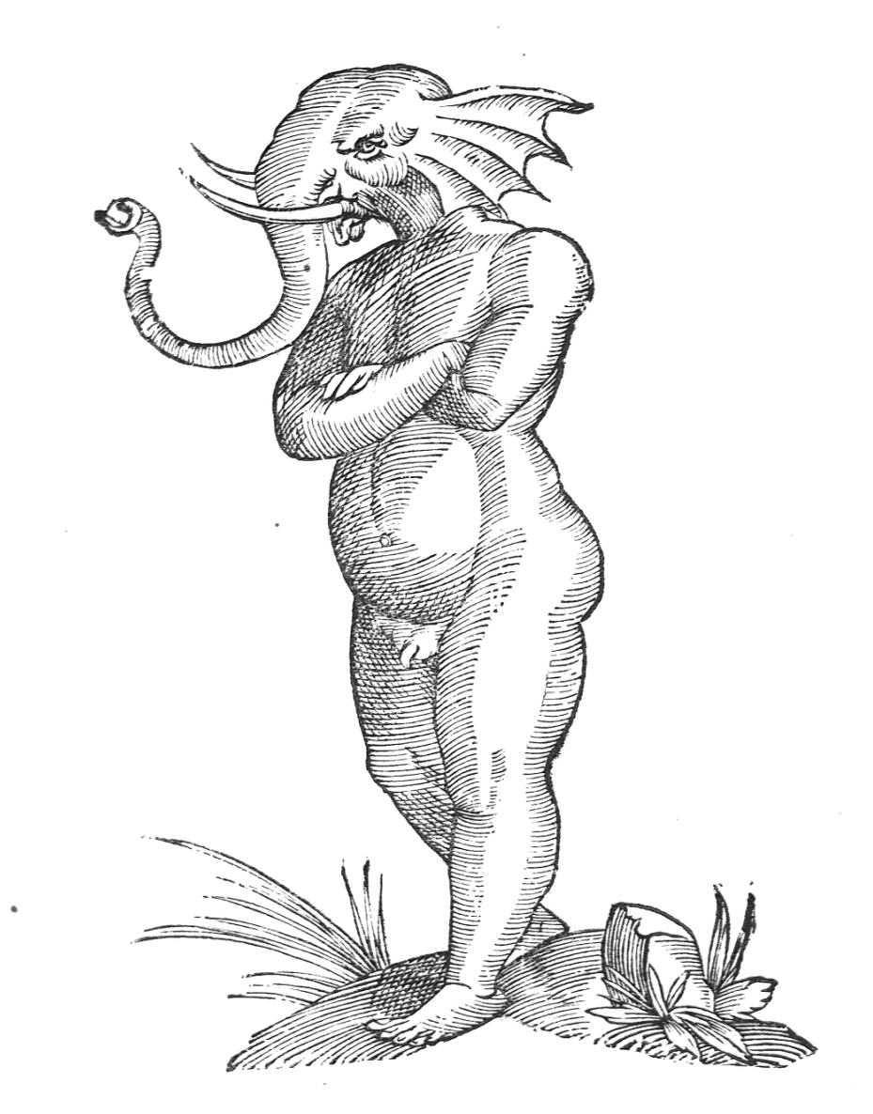

‘Life’ is full of monsters
Aldrovandi’s ‘Elephant Boy’, 1642

Slide 8
“Do you see this egg?”
“A vitalist, I would suggest, is someone who is led to reflect on the nature of life more because of the contemplation of an egg than because she has handled a hoist or a bellows” (Canguilhem 1980, 88)
“Do you see this egg? With this you can overthrow all the schools of theology, all the churches of the world. What is this egg? An unsensing mass, prior to the introduction of the seed [germe]; and after the seed has been introduced, what is it then? Still an unsensing mass, for the seed itself is merely an inert, crude fluid. How will this mass develop into a different [level of] organisation, to sensitivity and life? By means of heat. And what will produce the heat? Motion” (Diderot 1994, 618).

Slide 9
Natural history 1
Diderot: “We are on the verge of a great revolution in the sciences. Given the taste people seem to have for morals, belles-lettres, the history of nature and experimental physics, I dare say that before 100 years, there will not be more than three great geometricians remaining in Europe. The science will stop short where the Bernoullis, the Eulers, the Maupertuis, the Clairauts, the Fontaines and the D’Alemberts will have left... We will not go beyond (Pensées sur l’interprétation de la nature, 1753, § 4).
Maupertuis: natural history, if it is turned into a “real science,” should present “the general processes of Nature, in its production and preservation” (Lettre sur le progrès des sciences, 1752, § 13)

Slide 10
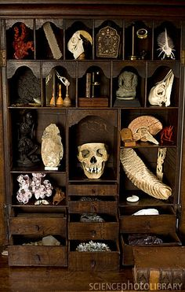
Natural history 2
Kant: “description of Nature” (Naturbeschreibung) vs. “history of nature” (Geschichte der Natur)
Treviranus: if botany and zoology are treated as parts of biology, they appear “in a new light,” no longer mere chunks of nomenclature, because they take a step beyond traditional classifications: “medicine, physiology and pathology will all be renewed” (Biologie, oder Philosophie der lebenden Natur, für Naturforscher und Aerzte, 1802, vol. I, 11n)

Slide 11
Biology as a science of living bodies:
“It includes everything pertaining to living bodies, especially their organization, the way it develops, its increasing composition throughout the prolonged activity of vital motions, its tendency to create specific organs, to isolate them, to centralize their action in a foyer, etc”
(Lamarck 1802, “Table raisonnée des matières,” 202).

Slide 12
Instead of big categories like ‘mechanism’ or ‘vitalism’:
“Kant is concerned not with the question of whether mechanism or vitalism (which arose in his lifetime) is right in biology but rather with the question of whether reductionism (which he considers to be the only scientific method) when applied to the organism displays a structural flaw that again and again necessitates teleological additions” (McLaughlin 1990, 3).

Slide 13
Philosophy of biology before biology: a provocation
For ‘organicists’ (Laubichler, Nicholson)
For ‘Kantians’ (and partisans of self-organization, and autonomy, and organizational closure: Kaufmann, Varela, Moreno et al.)
For ‘neomechanists’ (Craver)
PBBB is also in tension with ‘history of biology’ (often focused on social/cultural issues)
See:
Normandin and Wolfe eds., Vitalism and the Scientific Image (Springer, 2013)
Bognon-Küss and Wolfe eds., Philosophy of Biology before Biology (Routledge, forthcoming 2019)

